Slide 1


3 December, 2022
Sponsored and Supported by:

Slide 2
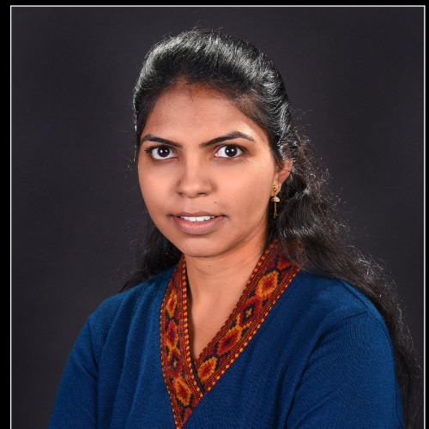

SPEAKERS PANEL
Session 5
Data Extraction using M365
11.50 AM -12.35 PM IST
Divya Akula
Technical Architect
Tarento Technologies

Slide 3
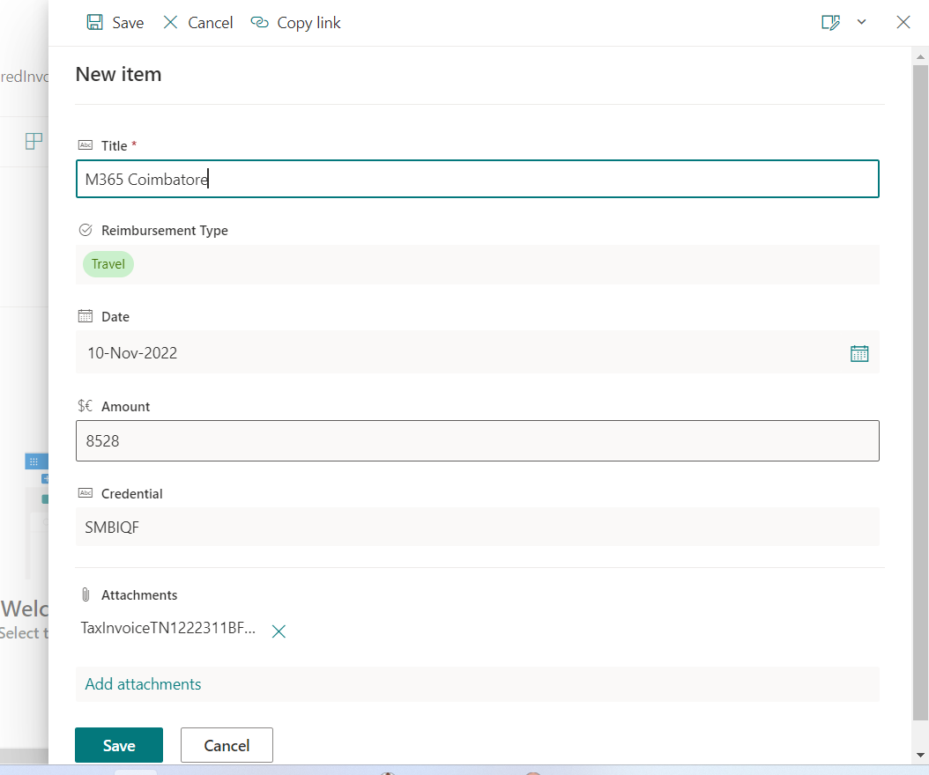
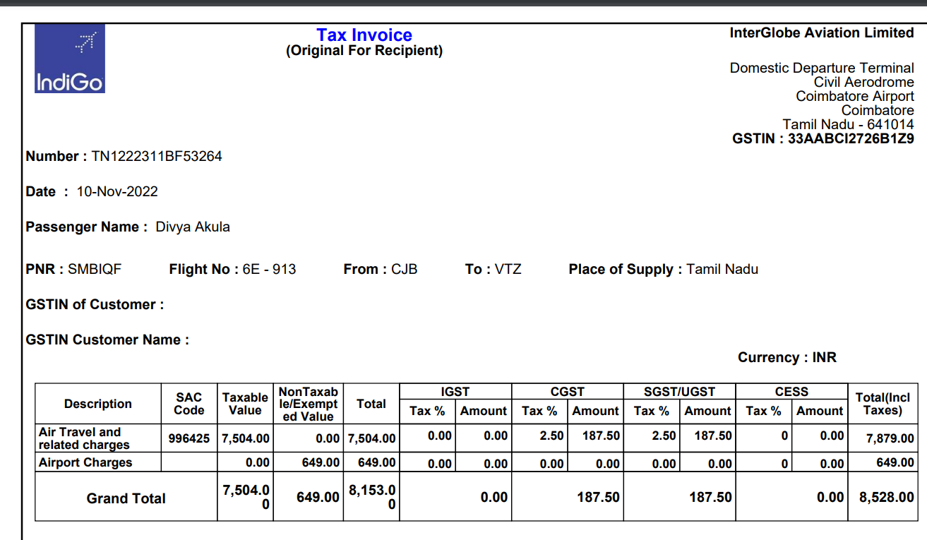
Scenario 1
Duplication of data
Manual validation
Approval system

Slide 4





Scenario 2
Types of Documents
Data dispersed in the documents
Embedded Data
Scanned documents
PDFs
Word Documents

Slide 5
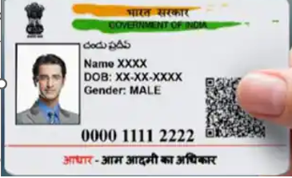



Types of data
Structured Data
Credit Note 1
The amount of 20,000/- is handed over to Mr.Navin Singh on date: 2012-10-09 with an interest rate of 7% bearing Aadhar number 1234-4567-01234 from FinOne finance Services
Credit Note 2
Mr. Navin Singh with Aadhar number 1234-4567-01235 has taken a credit from FinOne services for an amount of 20,000/- on 10-09-2012
unstructured Data
Semi structured Data

Slide 6
AI Models
Creation of Model
Uploading samples files
Creation of rules or identifying metadata
Testing the models
Understanding the accuracy
Application of model

Slide 7
Microsoft Syntex
Part of Microsoft Cortex
OCR based extraction
AI based extraction

Slide 8
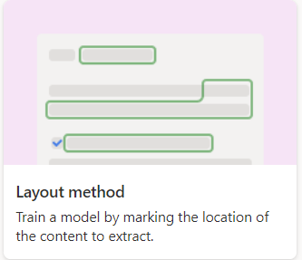
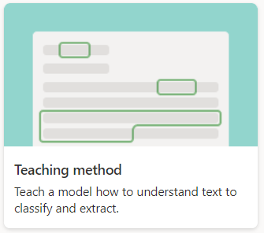
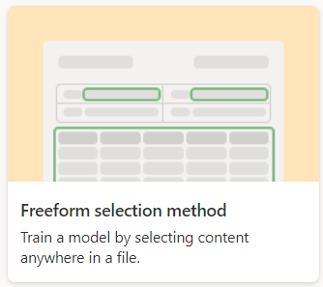
The 3 musketeers of MS-Syntex
Structured Data
Unstructured Data
Freeform Data

Slide 9
Dealing Structured Data with Syntex
Demo Time

Slide 10
Unstructured Data - Demo

Slide 11
Semi - structured Data

Slide 12

The Choice Of The Model
Structured Model
Freeform processing Model
Teaching Model
The James Mantra
Where
What
How
Licensing type that you own
AI Builder Credits
AI Builder Credits
SharePoint Syntex
Type of data
Structured
Unstructured & Structured
Unstructured
Language
73
English
73

Slide 13
Thank you

Slide 14







A Big Thank You to all the Sponsors!
Diamond:
Learning Partner:
Platinum:
Gold:

Slide 15


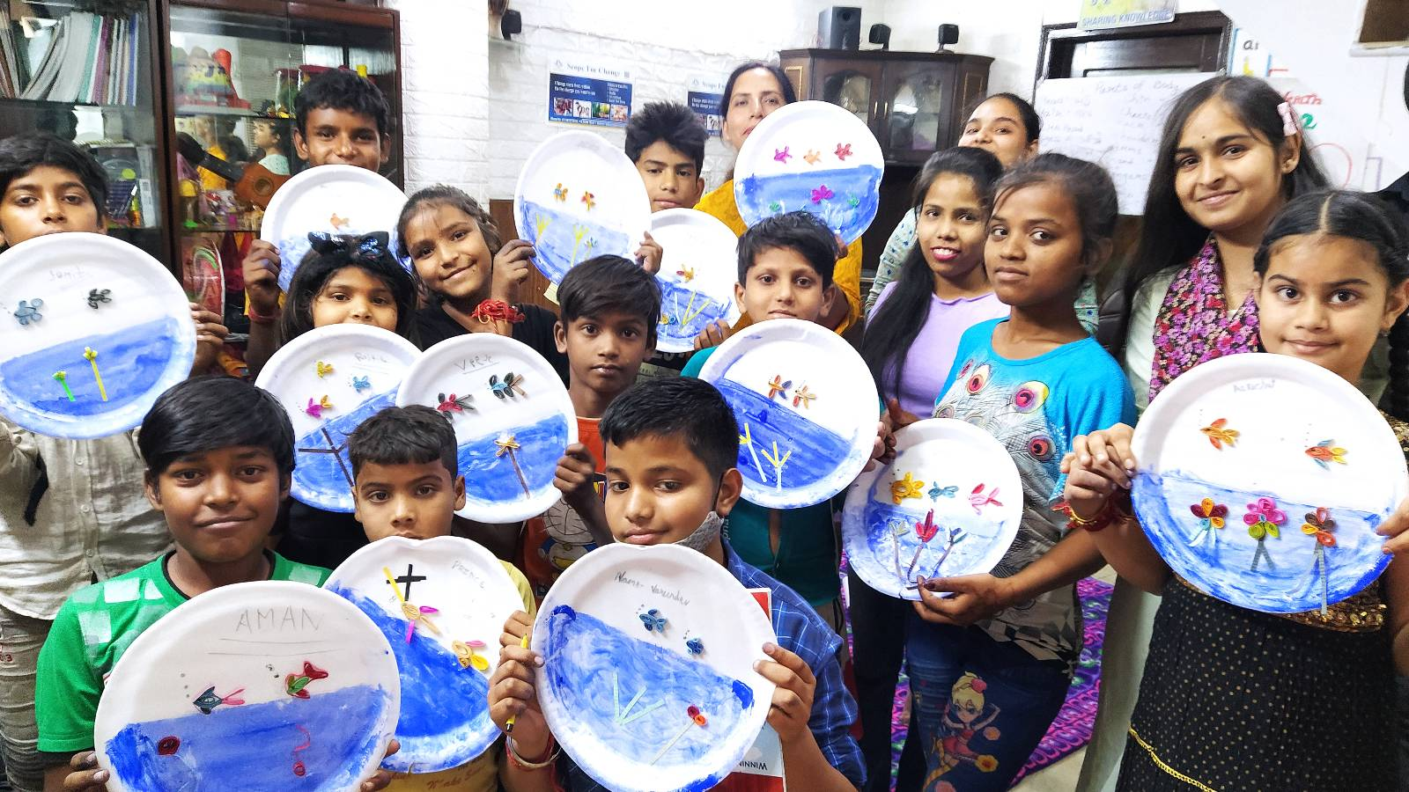

SUPPORT A CAUSE
“Giving is Receiving”
Support ‘Scope for Change’ to create more impact and touch the lives of more underprivileged students.

Slide 16

SPEAKERS PANEL
Session 6
Customise SharePoint List forms with SPFx Form Customizer Extension
Session Time: 02.00 AM – 2.45 PM
Siddharth Vaghasia
Independent Consultant

